Slide 2
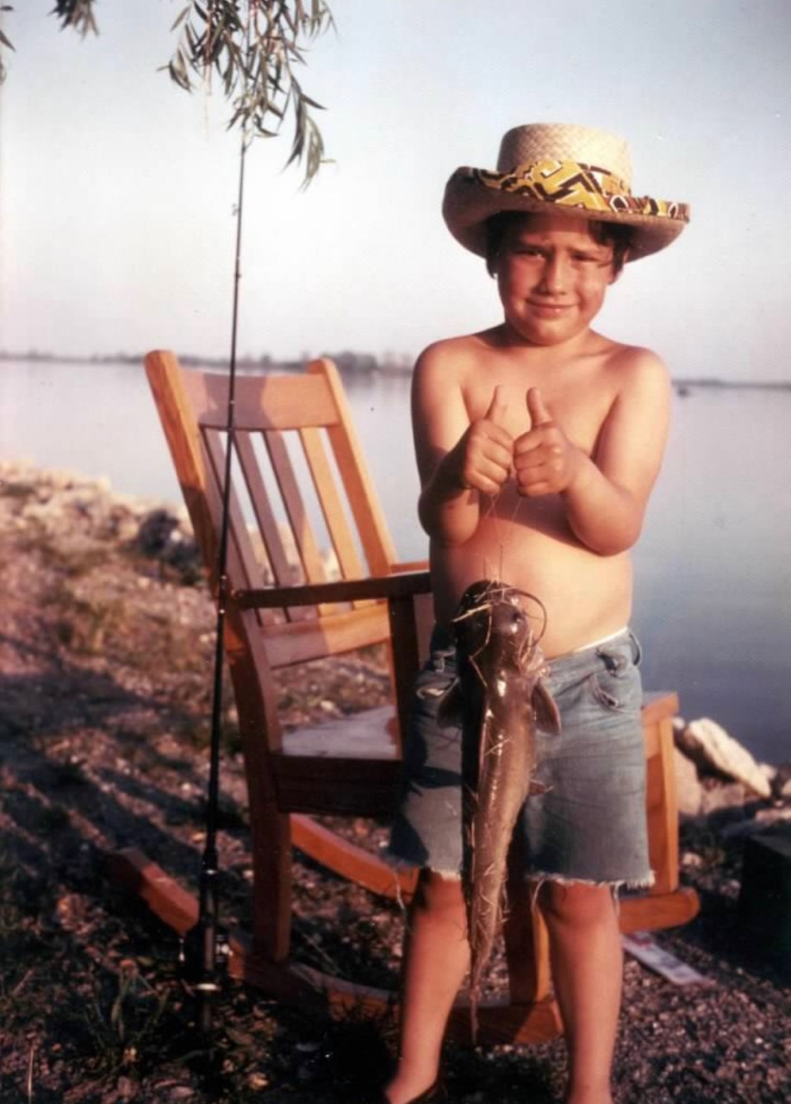
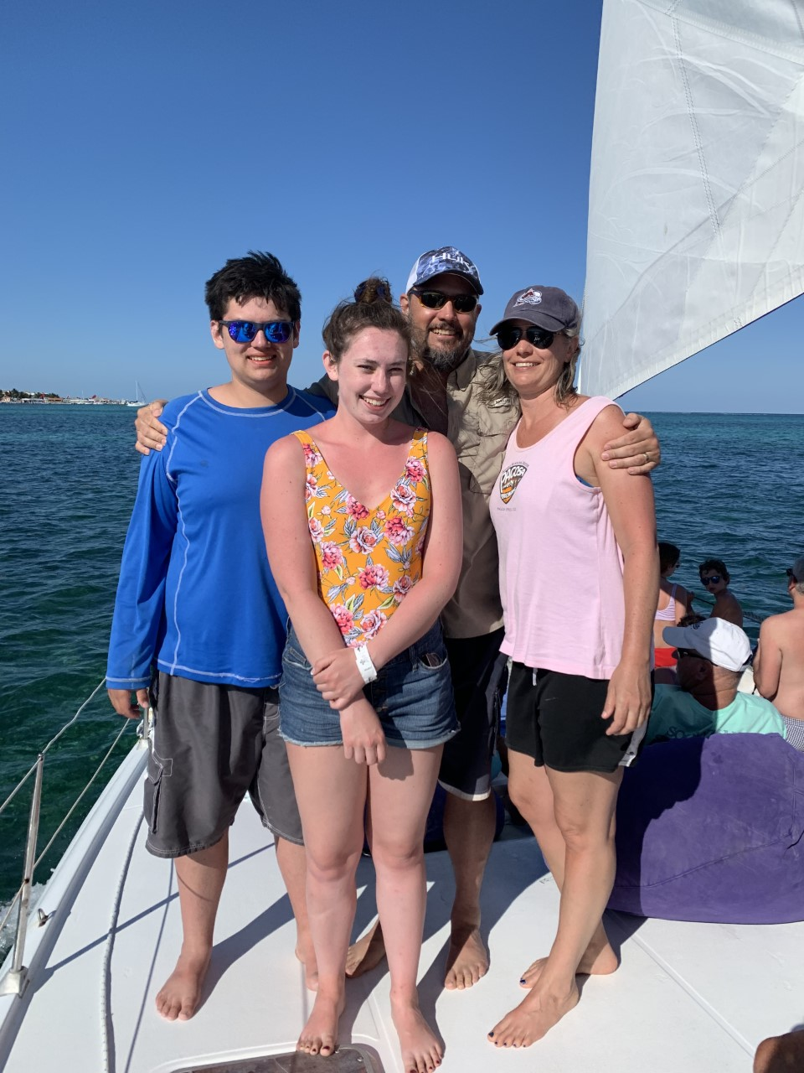

Slide 4
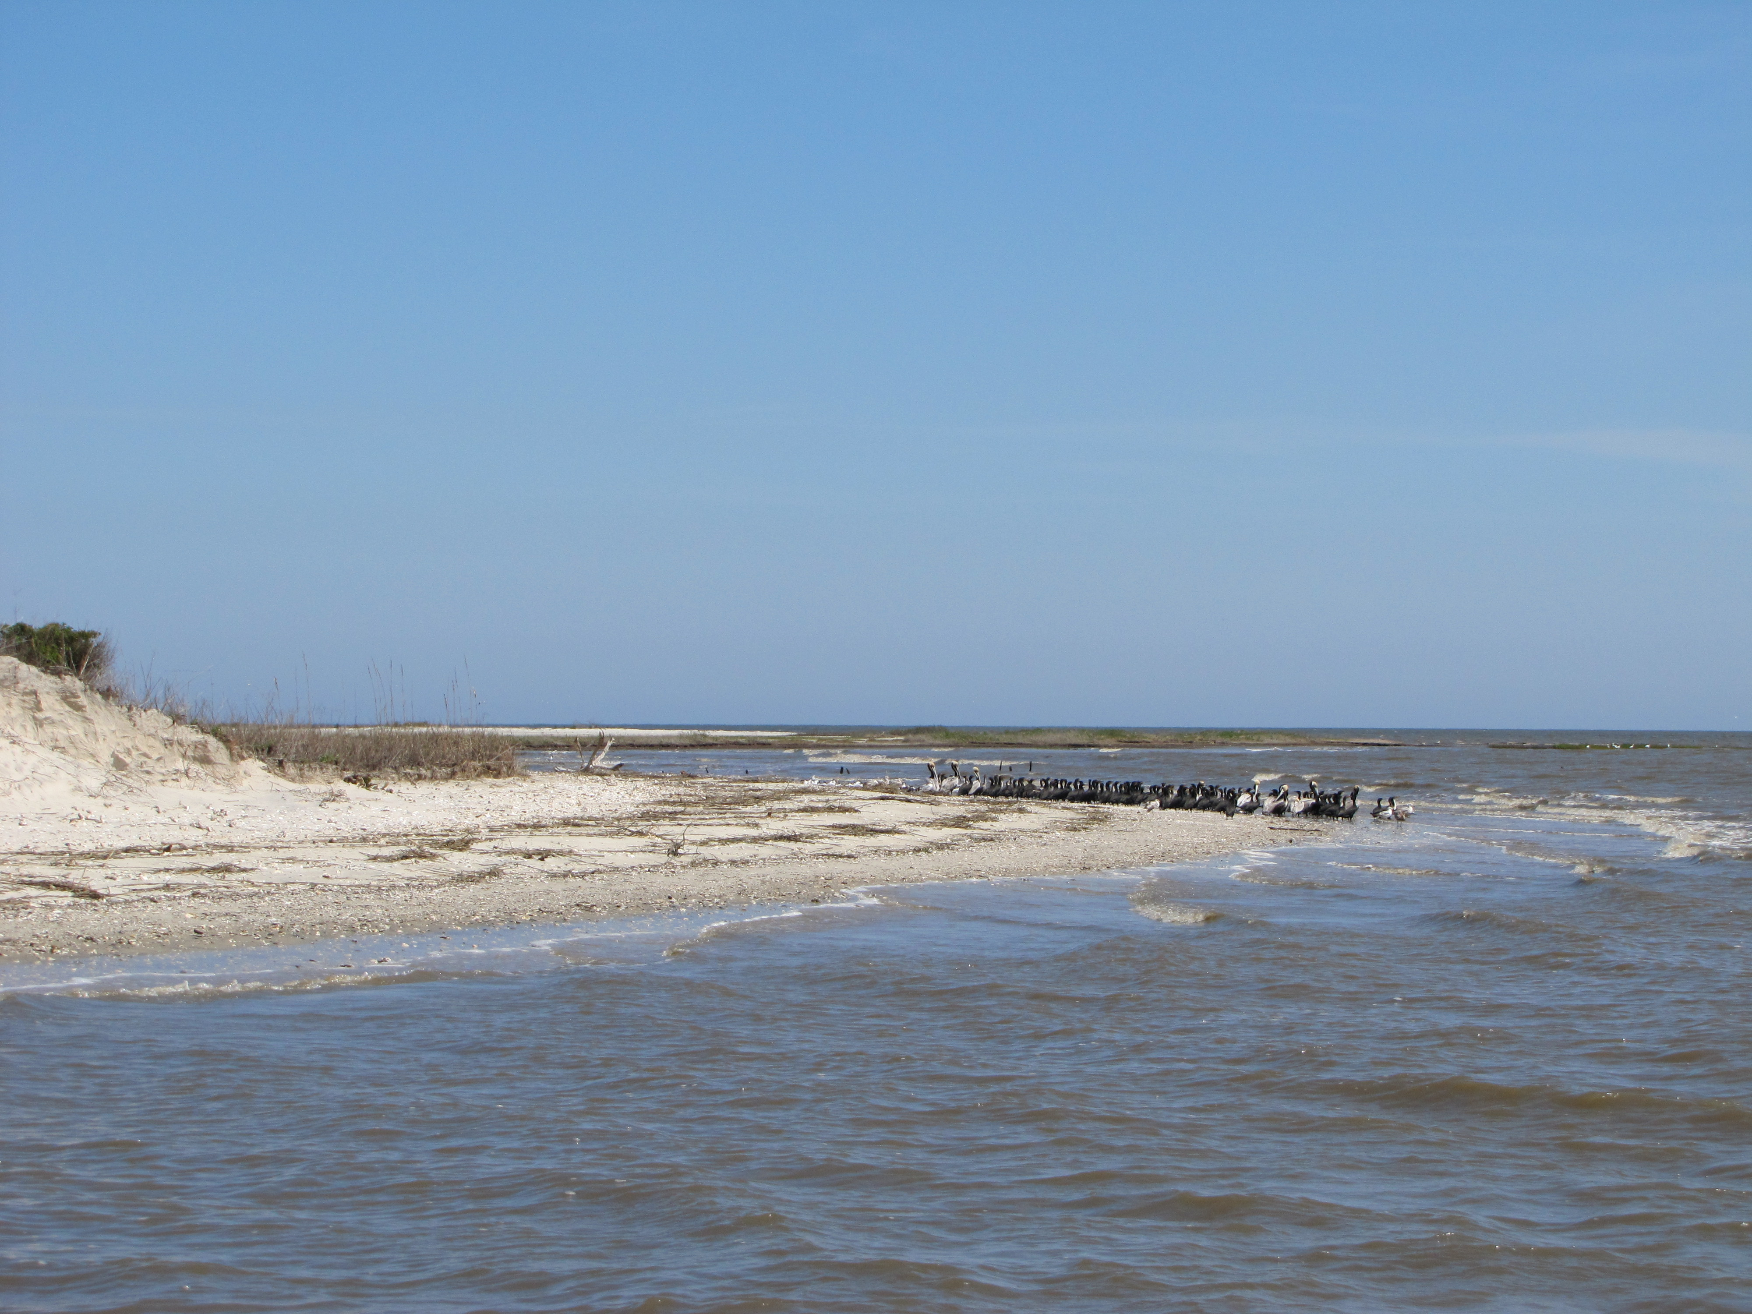
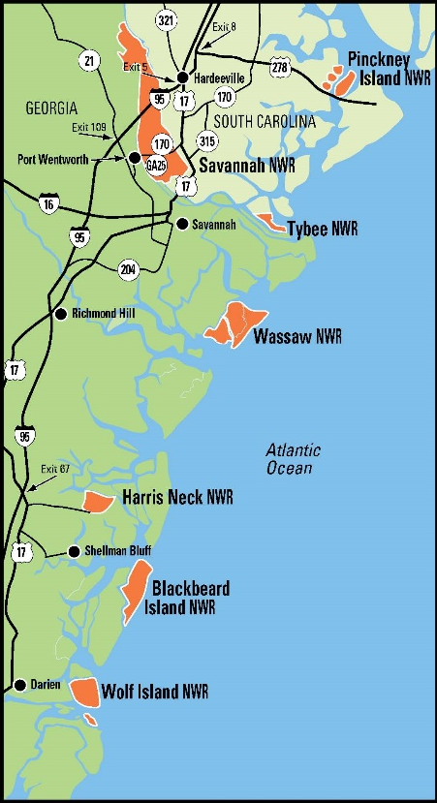
Refuges and Public Interaction
Urban Refuges – Savannah & Wassaw NWR
Tourist Destination – Pinckney Island NWR
Unsettled Challenges – Harris Neck NWR
Barrier Islands – Wassaw, Tybee, Blackbeard Island, Wolf Island NWR
Closed to the Public – Tybee & Wolf Island NWR
Wolf Island NWR

Slide 5
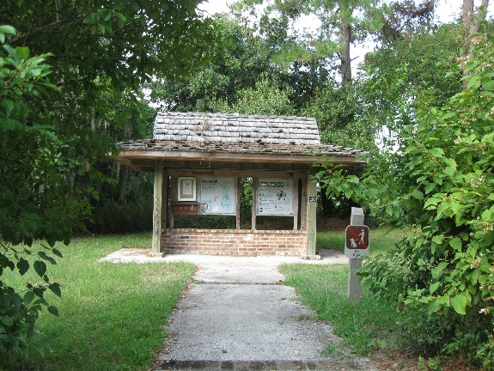
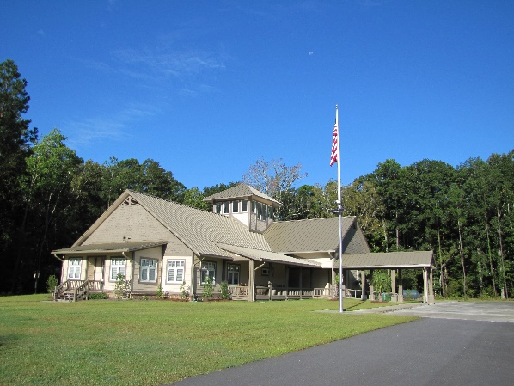
Visitor Services - Savannah
Savannah NWR
  Visitor Center/Complex Office – Built 2010 – Exhibits & Auditorium (40-60 people) with picnic tables (2014)
  Beech Hill Education Pavilion – Built 2019 – Screened 40x80 classroom with kitchen and restrooms
  RV Pads – Built 2010 – 2 at VC and 1 at Shop
  Wildlife Drive – 4.5 miles – Constructed in 1967
  Photo Blind – Wildlife drive, Cistern Trail – Built 2013 – 8x8
  Observation Deck/Fishing Pier – Built 2011 - Kingfisher Recreational Area
  Signage (Entrance, Interpretive, Directional, Regulatory)
  Welcome Kiosks (Wildlife drive and VC entrance)
  Trails -20 miles – (Wildlife drive, Kingfisher Recreational Area, Visitor Center)
  Pollinator Garden - Office
  5 Station AM Transmitter Audio Tour – Wildlife Drive – Installed 2013
  Bunkhouse – for volunteers, fire crews, researchers, interns

Slide 6
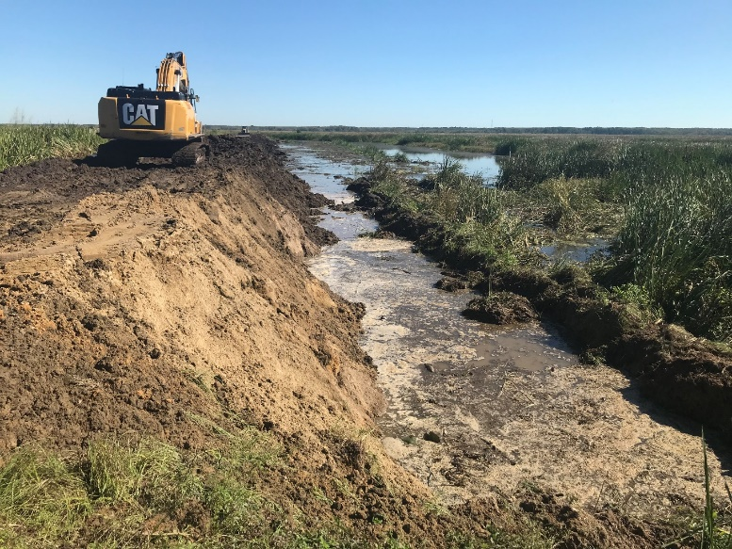
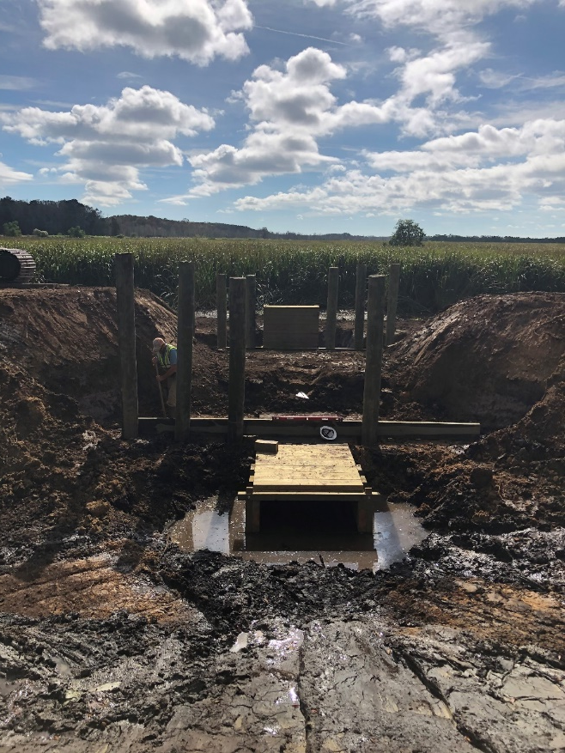
Hurricane IRMA Impoundment Repair
  The refuge provides virtually the only publicly-owned conservation area in the lower Savannah River estuary whose primary objectives center on waterfowl and other wetland-dependent migratory birds.
  Development in the Savannah River estuary has reduced tidal freshwater wetlands by two-thirds elevating the importance of managed freshwater wetlands on the Savannah NWR within the impoundment system.
  Over the past several decades, the levees have subsided with many areas of the perimeter levees well below the original 12' elevation above mean sea level (MSL)
  Sea level rise, increasing frequency of high tides above 9', deepening of the Savannah Harbor with associated increases in salinity, and potential increase in hurricane activity necessitate the recovery of the entire network of levees to function and support refuge purpose.
Notes:
Brief overview of the Refuge
Nearly a century old
started with only 2.352 acres
Now up to 31.450 including the SHEP mitigation acquisitions – Abercorn Island and SLF III
Majority of the refuge is wetlands with two major types – tidal freshwater forested and tidal freshwater emergent
The basic objectives are to provide habitat for migratory and wintering birds, specifically waterfowl.
The primary means of meeting our objectives is through management of the freshwater impoundments.

Slide 7
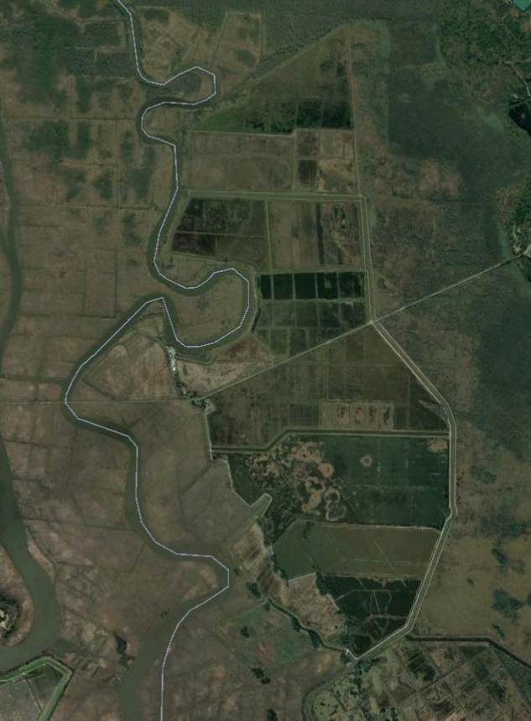
Long-billed Curlew
Long-billed Curlew
Priority Components
FUNDED
Pool 1
50 Priorities Identified by USFWS
Priorities based on pool value – effective management and migratory bird use.
Priorities 1 – 31A (FUNDED)
  Dikes – Re-top and Berm
  Interior Ditches
  Rice Trunks (8)
  Ramps (20)
  Spillbox (1)
Costs
  Survey/Design: $477,627.67
  Construction Cost: $11,939,316.96
Total Cost:
$12,416,944.63 (+ additional $5M)
Pool 2
Pool 3
Pool 4
Pool 5
Heavy Equipment /Service Vehicle Access
Pool 8
Pool 6
Pool 7
Pool 11
Pool 10
Pool 12/13
Pool 15
Pool 14
Pool 16
Pool 17
Pool 18
Notes:
Brief overview of the Refuge
Nearly a century old
started with only 2.352 acres
Now up to 31.450 including the SHEP mitigation acquisitions – Abercorn Island and SLF III
Majority of the refuge is wetlands with two major types – tidal freshwater forested and tidal freshwater emergent
The basic objectives are to provide habitat for migratory and wintering birds, specifically waterfowl.
The primary means of meeting our objectives is through management of the freshwater impoundments.

Slide 8
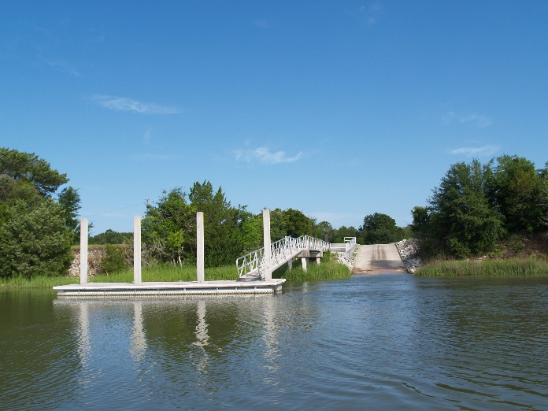
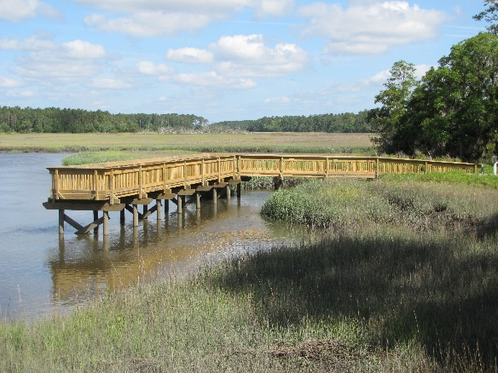
Visitor Services- Harris Neck
Harris Neck
  Contact Station – Built 2004
  RV Pads - 6
  Wildlife Drive – 4 miles
  Two Fishing Piers – Entrance to refuge
  Boat Ramp and parking area – Barbour River
  Signage (Entrance, Interpretive, Directional, Regulatory)
  Welcome kiosk – Entrance to refuge, Barbour river (under construction)
  Trails -15 miles – (Wildlife drive)
  Pollinator Garden – Office
  Bunkhouse – for volunteers, researchers, and interns

Slide 9
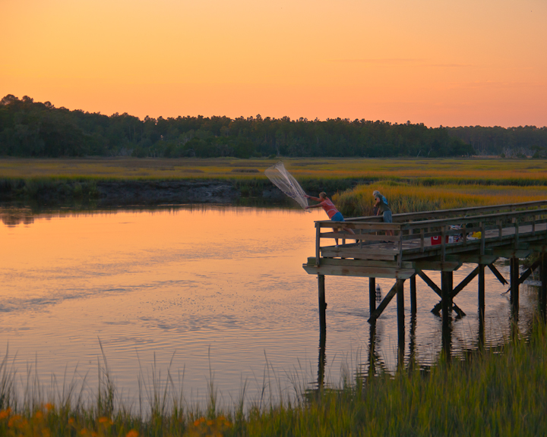
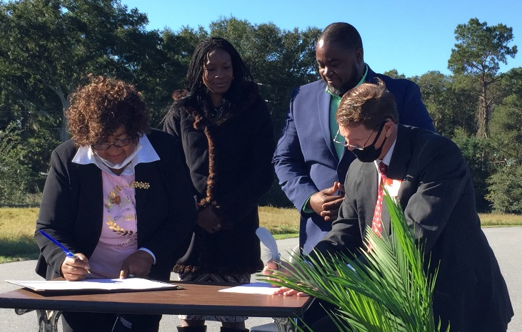
Complex Highlights
MOU with Direct Descendants of Harris Neck Community
(October 30, 2020)
Critter Christmas
Harris Neck NWR

Slide 10
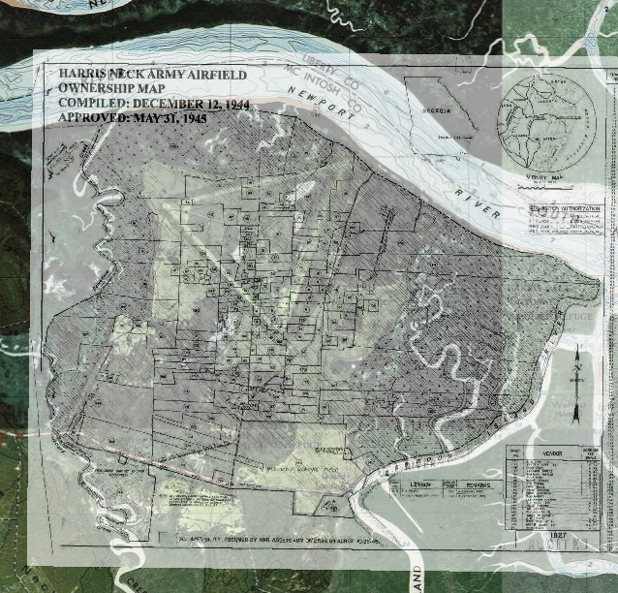
History of DDHNC
Direct Descendants of Harris Neck formed last year
Signing of MOU event in October 2020 with past FWS Director
Community engagement
Highlight both the NWR and cultural significance

Slide 11
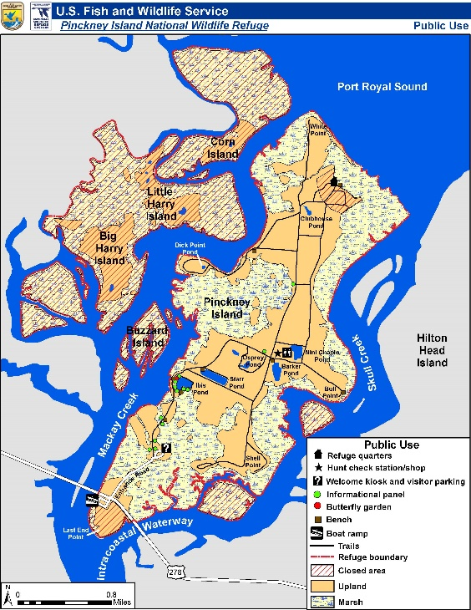
Visitor Services – Pinckney Island
Pinckney Island
  Meeting/House Facility – Built 1957 – for programs/events and housing ( volunteers, researchers, interns)
  Wildlife Observation Station – Built 2020 – 20x24 with 4 picnic tables – at Ibis Pond
  Pole Barn with adjacent restrooms – used as event and education program site
  Signage (Entrance, Interpretive, Directional, Regulatory)
  Welcome kiosk and Trailhead kiosk – Parking lot
  Trails - 14 miles – (Wildlife drive)
  Pollinator Garden – Ibis Pond

Slide 12
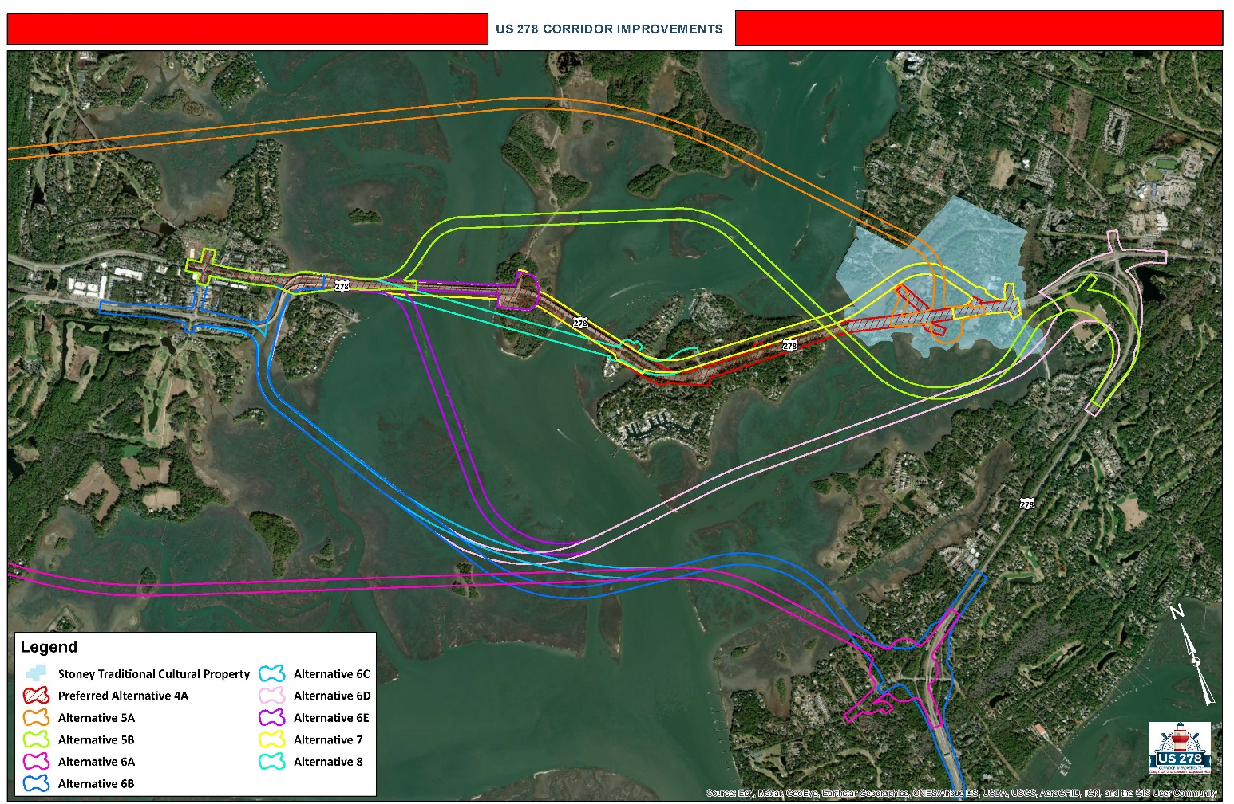
Highway 278/Pinckney Island
Project has been fully funded
  $40 Million for eastbound Mackay Creek bridge – SCDOT/FHWA
  $120 Million from State Infrastructure bank
  $80 Million additionally from Beaufort County One Cent Sales Tax
Expected outcomes:
  12’ ped/bicycle lane parallel to roadway
  One six lane bridge flying over Pinckney Island
  Off/On-ramps eliminating middle interchange
Projected construction date is late 2023/2024
SCDOT’s website – more information

Slide 13
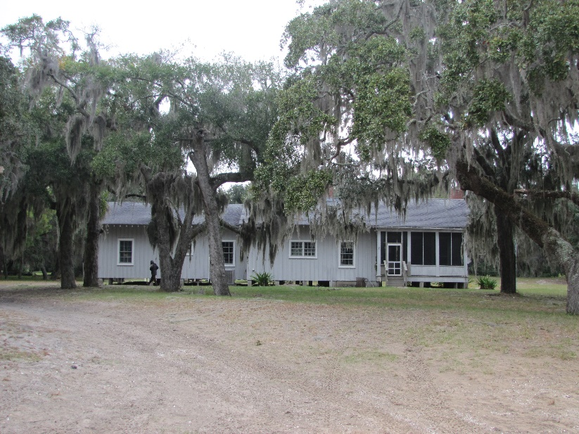
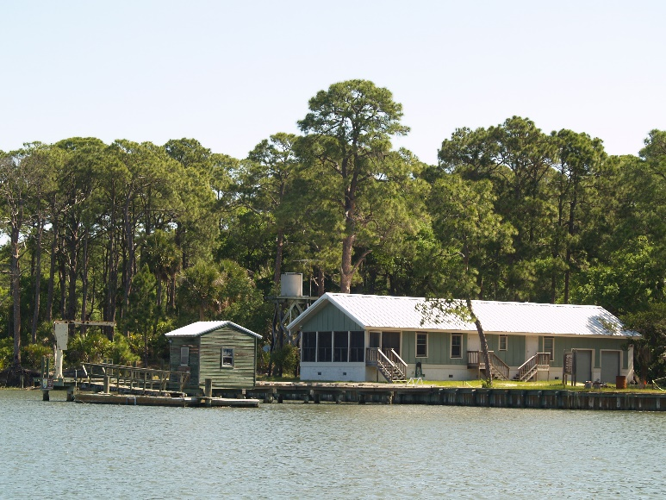
Visitor Services – Barrier Island Refuges
Blackbeard Island
  Signage (Entrance, Interpretive, Directional, Regulatory)
  Trails -14 miles – (Wildlife drive)
  Welcome Kiosk
  Boat Dock – Built 2009
  Main House – Historical
  Research Quarters – Built 2001
  Restrooms at Hunter Campground – Built 2013
Wassaw
  Signage (Entrance, Interpretive, Directional, Regulatory)
  Trails -20 miles
  Welcome Kiosk
  Boat Dock – Built 2017
  House – Built 2011
Wolf Island
  Signage – 2 Informational
Tybee Island
  Nothing

Slide 14
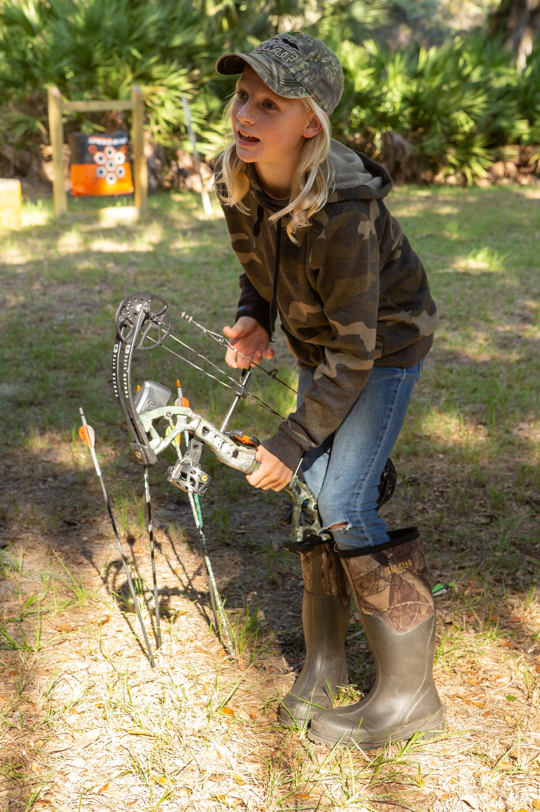
Hunting and Fishing
Status of special hunts
Harris Neck Hunt Plan for 2021/22 is in the final stages for next hunt season.
  Add two days to the second managed deer hunt
  Add a two-day, archery youth turkey hunt.
  Add feral hog, coyote, and armadillo as incidental species
Blackbeard Island (2022/23)
  Add a general archery hunt one week after the end of the second managed hunt until the end of deer season.
  Add alligator hunting in the salt marsh between Sapelo and Blackbeard
  Add feral hog, coyote, armadillo, raccoon, opossum, and fox as incidental species.
Wassaw (2022/23)
  Add feral hog, coyote, armadillo, raccoon, opossum, and fox as incidental species.
  No changes to deer hunting (Deed restriction to have personnel supervise the hunt)

Slide 15
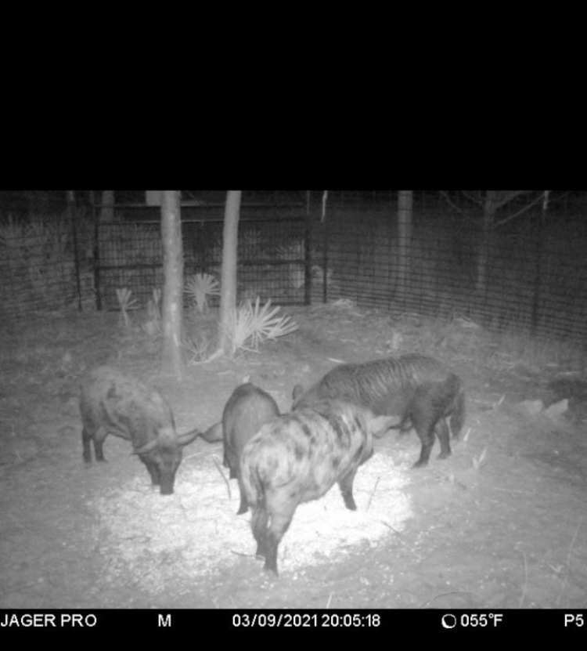
Invasive Species Grant
  In 2021 we submitted a grant for control on invasive species on Blackbeard Island and Wassaw NWRs.
  The grant would focus on removal of feral pigs and coyotes.
  The key to the grant would be hiring a temporary biological technician for up to 3 years to focus on the project.
  Awarded funding in May.

Slide 16
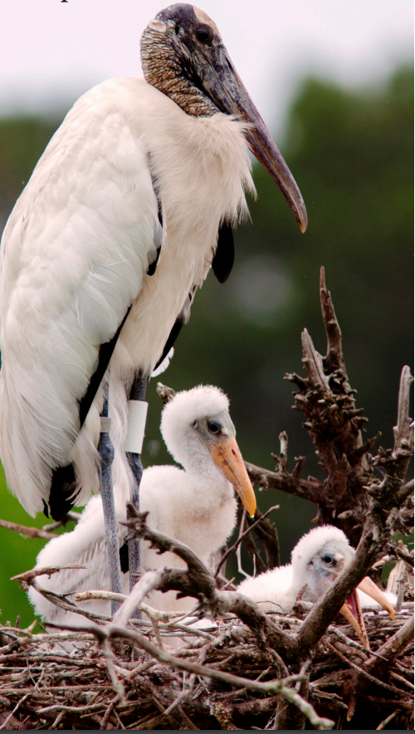
Surveys and Plans
Shorebirds
  International Shorebird Surveys are being conducted now.
Wood storks
  Monitoring of wood storks has started with MaryLou Dickson as our observer.
Sea Turtles
Draft HMPs are partially complete for Harris Neck, Blackbeard, Wassaw, and Wolf Island NWRs

Slide 17
Four Pillars = where opportunity lies
There is always opportunity with change
Build Back Better – GAOA, DM, MAT
Pandemic – Outdoor recreation
Social Equity – recruitment and engagement
Climate Change – Civilian Climate Corps, resilience

Slide 18
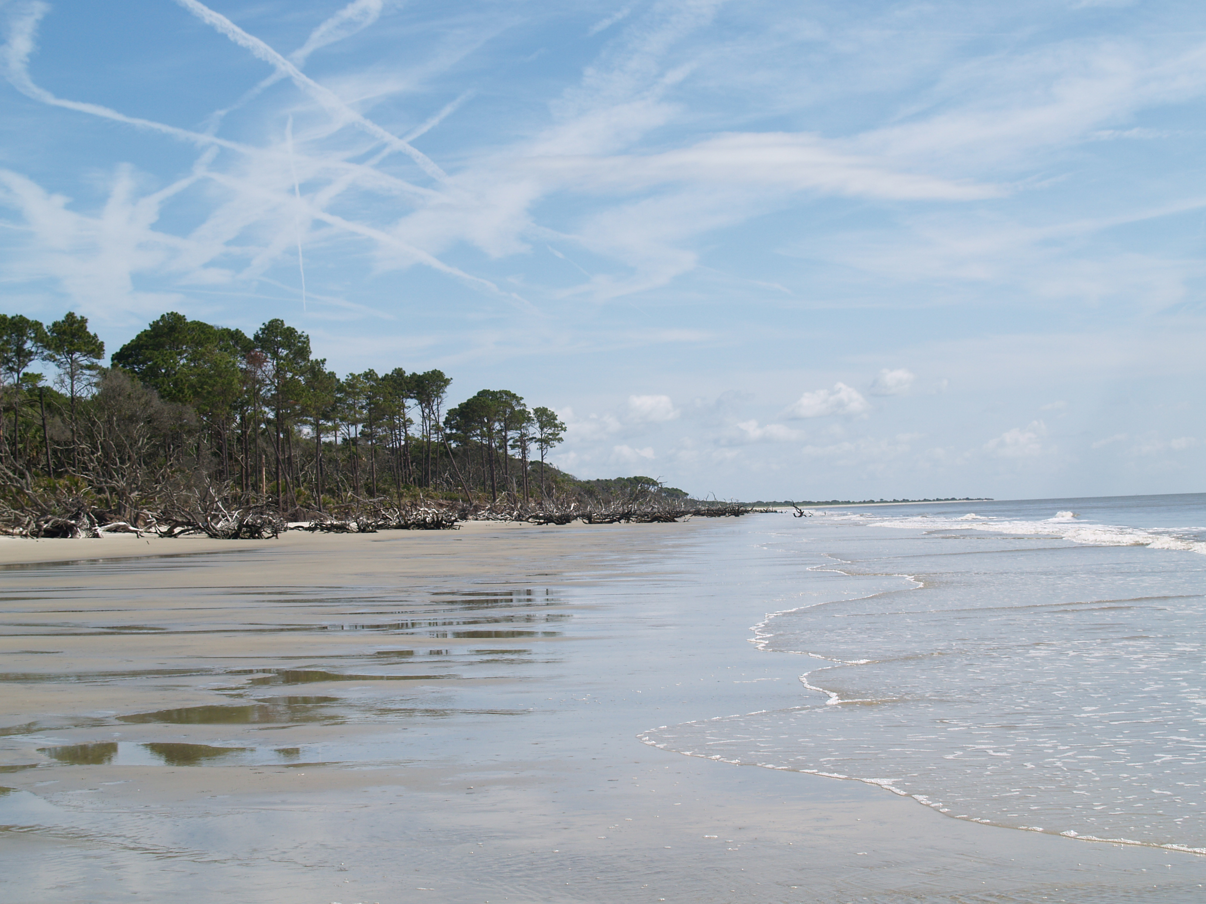
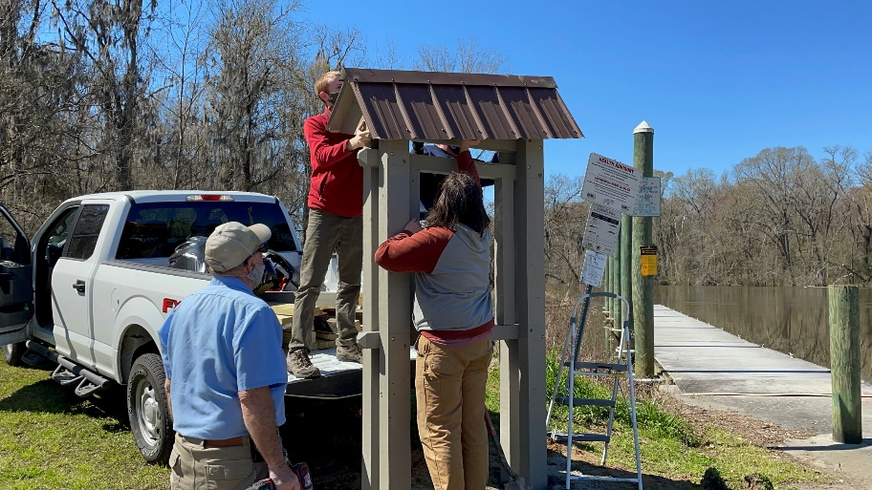
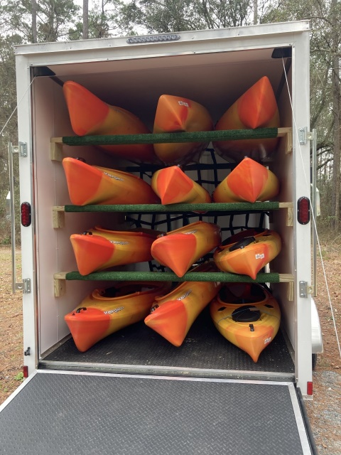
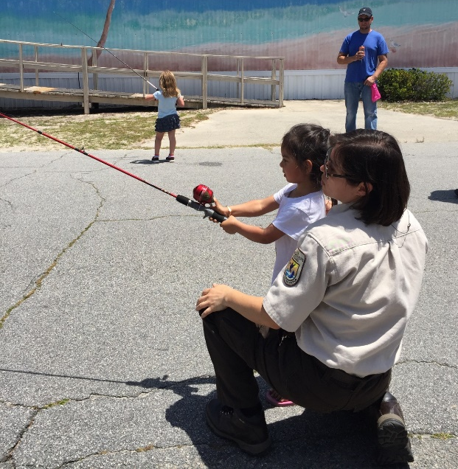
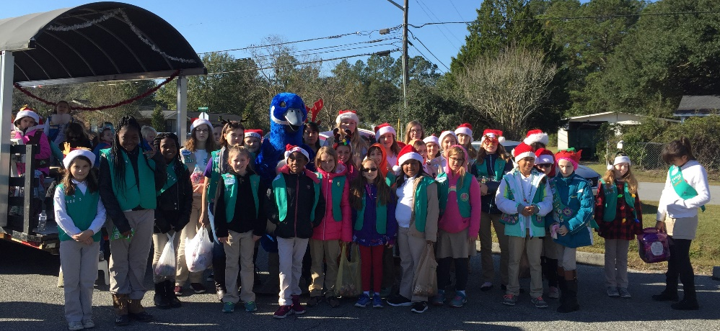
Complex Highlights
Community Engagement/Urban Program
Blackbeard NWR
Notes:
We plan to continue with community engagement activities - youth of all backgrounds and abilities can have the opportunity to learn and enjoy the out-of-doors– received funding from Washington Office to start an outdoor skills program with Girl Scout being our partner – equal a travel archery/casting and paddling program

Slide 19
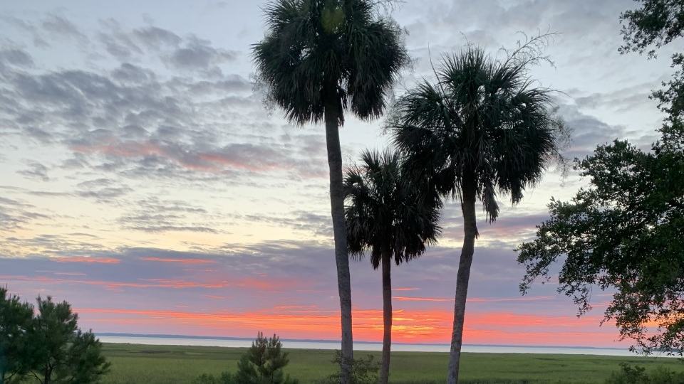
Thank you!
Will Meeks
will_meeks@fws.gov

